Slide 1

Bootstrap
By : Dr. Naveen Tewari

Slide 2
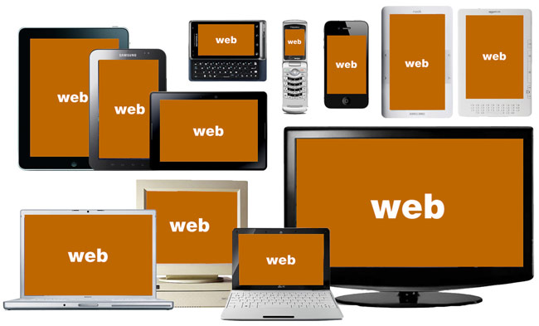
State of web today

Slide 3
mobile only web users
mobile is huge
1 billion active mobile broadband subscriptions
One for every 7 people on earth access web in mobile

Slide 4
What is Bootstrap?
A freely available design framework for responsive websites and web applications.
Based upon HTML5, CSS and JavaScript.
Supports all major browsers (even IE7!).
Released on 2011.

Slide 5

What is Responsive Web Design?
Responsive web design is about creating web sites which automatically adjust themselves to look good on all devices, from small phones to large desktops.
Design is a process for developing solutions that effectively integrate task,
context of use, and “user.”

Slide 6

Why Bootstrap?
Most popular responsive web framework at present.
Easy to use: Anybody with just basic knowledge of HTML and CSS can start using Bootstrap.
Bootstrap is compatible with all modern browsers .
Designed for everyone, everywhere.

Slide 7
Adding Bootstrap to Your Web Pages
<!DOCTYPE html>
<html>
<head>
<title>Page Title</title>
<meta name="viewport" content="width=device-width, initial-scale=1">
<link rel="stylesheet" href="http://maxcdn.bootstrapcdn.com/bootstrap/3.3.6/css/bootstrap.min.css"> <script src="https://ajax.googleapis.com/ajax/libs/jquery/1.11.3/jquery.min.js"></script> <script src="http://maxcdn.bootstrapcdn.com/bootstrap/3.3.6/js/bootstrap.min.js"></script>
</head>
<body>
…
</body>
</html>

Slide 8
Bootstrap Pages
Inside the <body> tag
Bootstrap requires a containing element to wrap site contents with class="container"
<div class="container"> <h1>My First Bootstrap Page</h1> <p>This is some text.</p> </div>
Note: Any valid HTML markup can be used inside a page

Slide 9
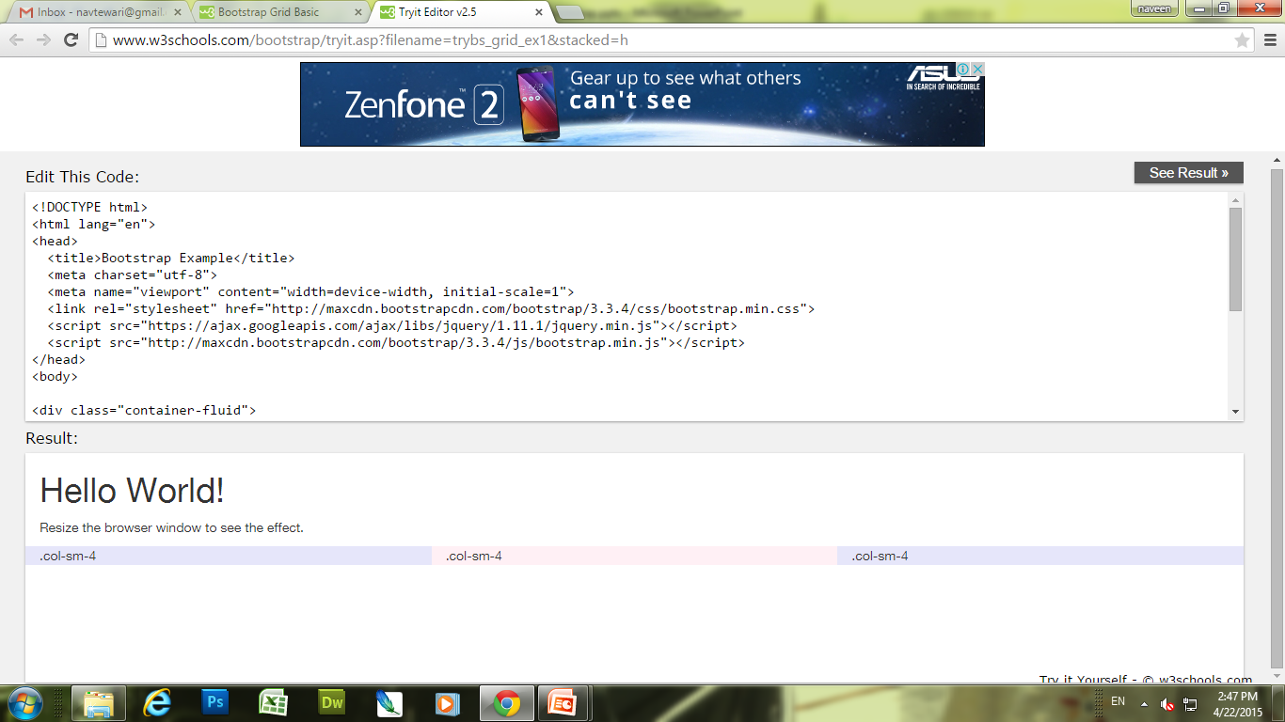
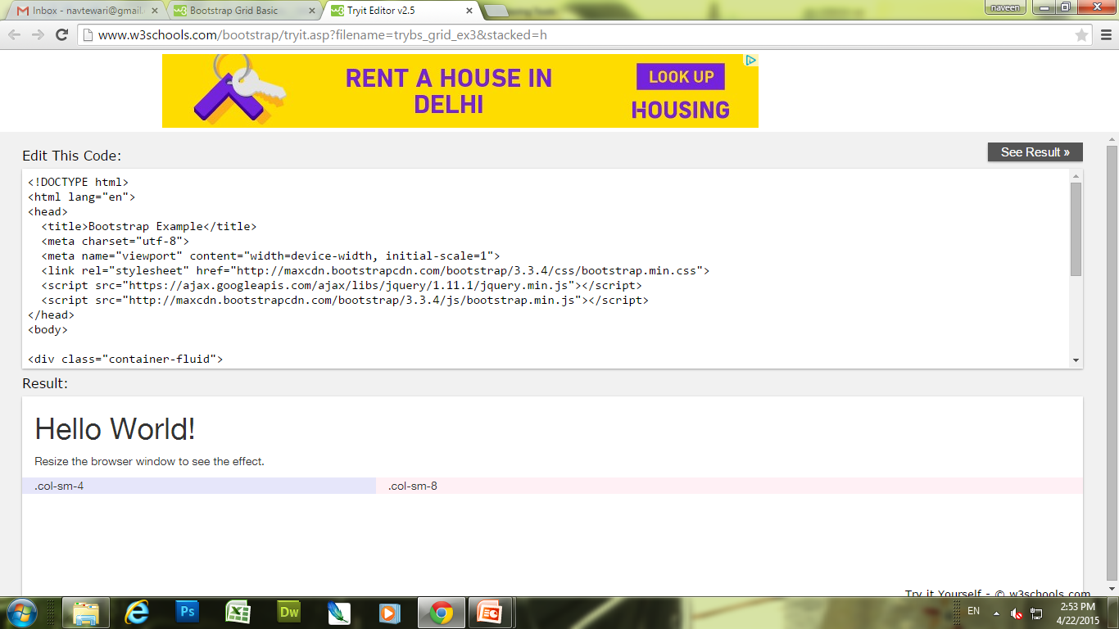
Bootstrap Grid
Bootstrap's grid system allows up to 12 columns across the page.
<div class="row"> <div class="col-sm-4">.col-sm-4</div> <div class="col-sm-4">.col-sm-4</div> <div class="col-sm-4">.col-sm-4</div> </div>
<div class="row"> <div class="col-sm-4">.col-sm-4</div> <div class="col-sm-8">.col-sm-8</div> </div>

Slide 10
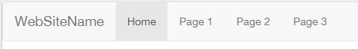
Bootstrap Nav-bars
A navigation bar is a navigation header that is placed at the top of the page.
With Bootstrap, a navigation bar can extend or collapse, depending on the screen size.
A standard navigation bar is created with <nav class="navbar navbar-default">.
<div class="navbar navbar-default">
<div class="container-fluid">
<div class="navbar-header">
<a class="navbar-brand" href="#">WebSiteName</a>
</div>
<div>
<ul class="nav navbar-nav">
<li class="active"><a href="#">Home</a></li>
<li><a href="#">Page 1</a></li>
<li><a href="#">Page 2</a></li>
<li><a href="#">Page 3</a></li>
</ul>
</div>
</div>
</div>

Slide 11
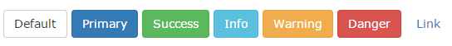
Bootstrap Buttons
Bootstrap provides seven styles of buttons:
<button type="button" class="btn btn-default">Default</button> <button type="button" class="btn btn-primary">Primary</button> <button type="button" class="btn btn-success">Success</button> <button type="button" class="btn btn-info">Info</button> <button type="button" class="btn btn-warning">Warning</button> <button type="button" class="btn btn-danger">Danger</button> <button type="button" class="btn btn-link">Link</button>

Slide 12
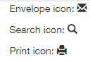
Bootstrap Glyphicons
Bootstrap provides 200 glyphicons.
Glyphicons can be used in text, buttons, toolbars, navigation, forms, etc.
<p>Envelope icon: <span class="glyphicon glyphicon-envelope"></span></p> <p>Search icon: <span class="glyphicon glyphicon-search"></span></p> <p>Print icon: <span class="glyphicon glyphicon-print"></span></p>

Slide 13
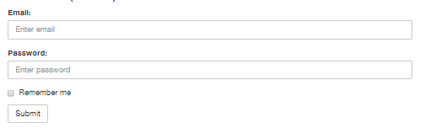
Bootstrap Forms
Form controls automatically receive some global styling with Bootstrap:
<form role="form"> <div class="form-group"> <label for="email">Email address:</label> <input type="email" class="form-control" id="email"> </div> <div class="form-group"> <label for="pwd">Password:</label> <input type="password" class="form-control" id="pwd"> </div> <div class="checkbox"> <label><input type="checkbox"> Remember me</label> </div> <button type="submit" class="btn btn-default">Submit</button> </form>

Slide 14
THANK YOU

